Slide 1


What is Artificial intelligence?
Introduction to Reinforcement learning
Abdallah Hesham Mohamed

Slide 2
Can we define AI?
“Artificial Intelligence (AI) is the part of computer science concerned with designing intelligent computer systems, that is, systems that exhibit characteristics we associate with intelligence in human behavior – understanding language, learning, reasoning, solving problems, and so on.” - (Barr & Feigenbaum, 1981)
“The Ability to learn to make decisions to achieve goals”

Slide 3
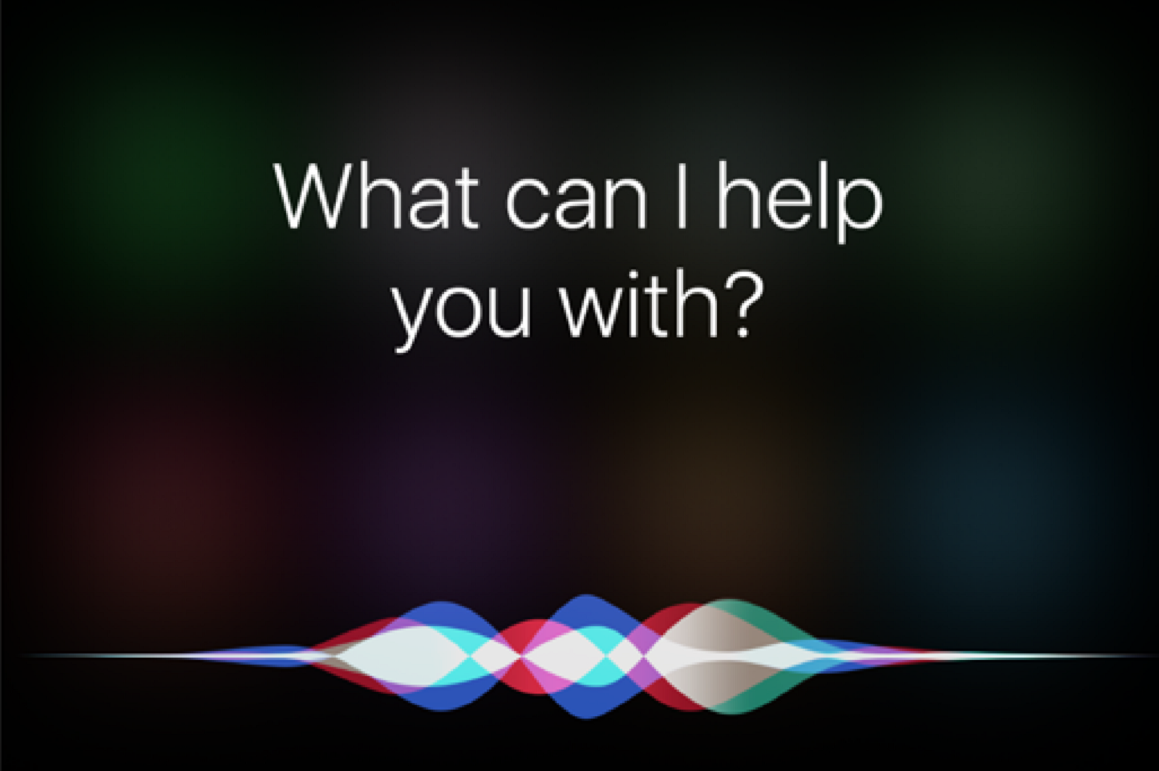
Some forms of AI
Alexa, Siri and google assistant
Washing machines
YouTube recommendations
Dancing robot?

Slide 4
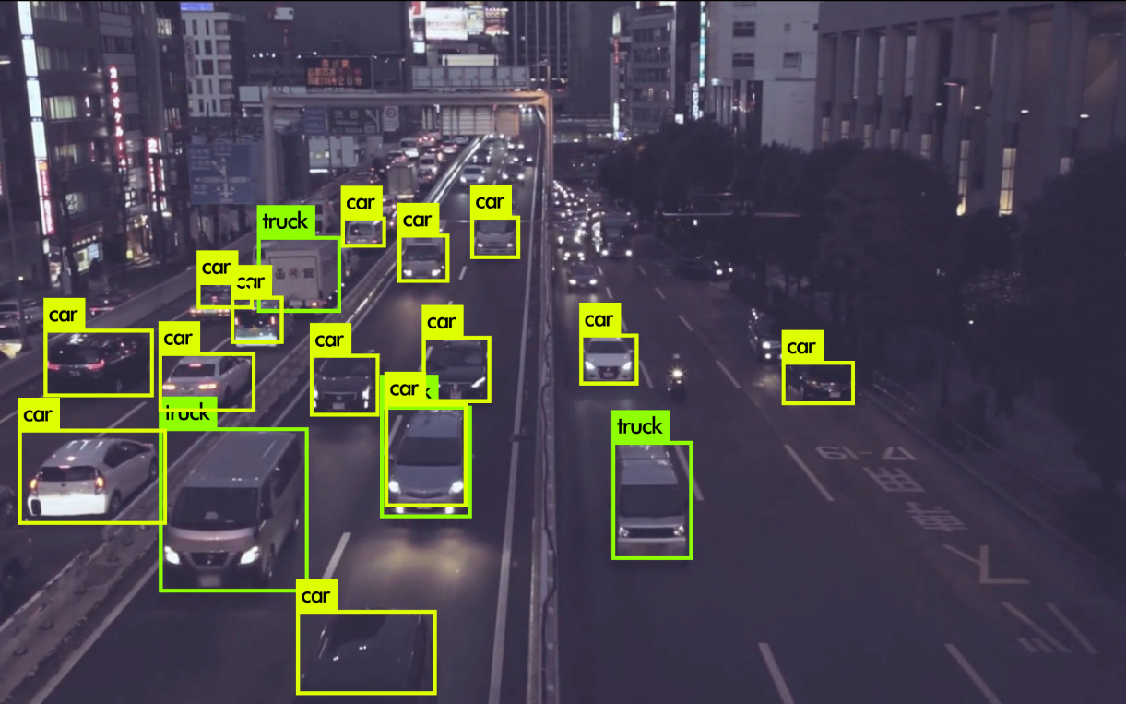
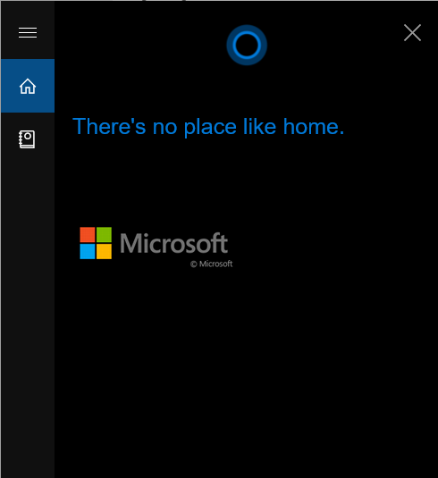
More AI
Source
Cortana’s smart response

Slide 5
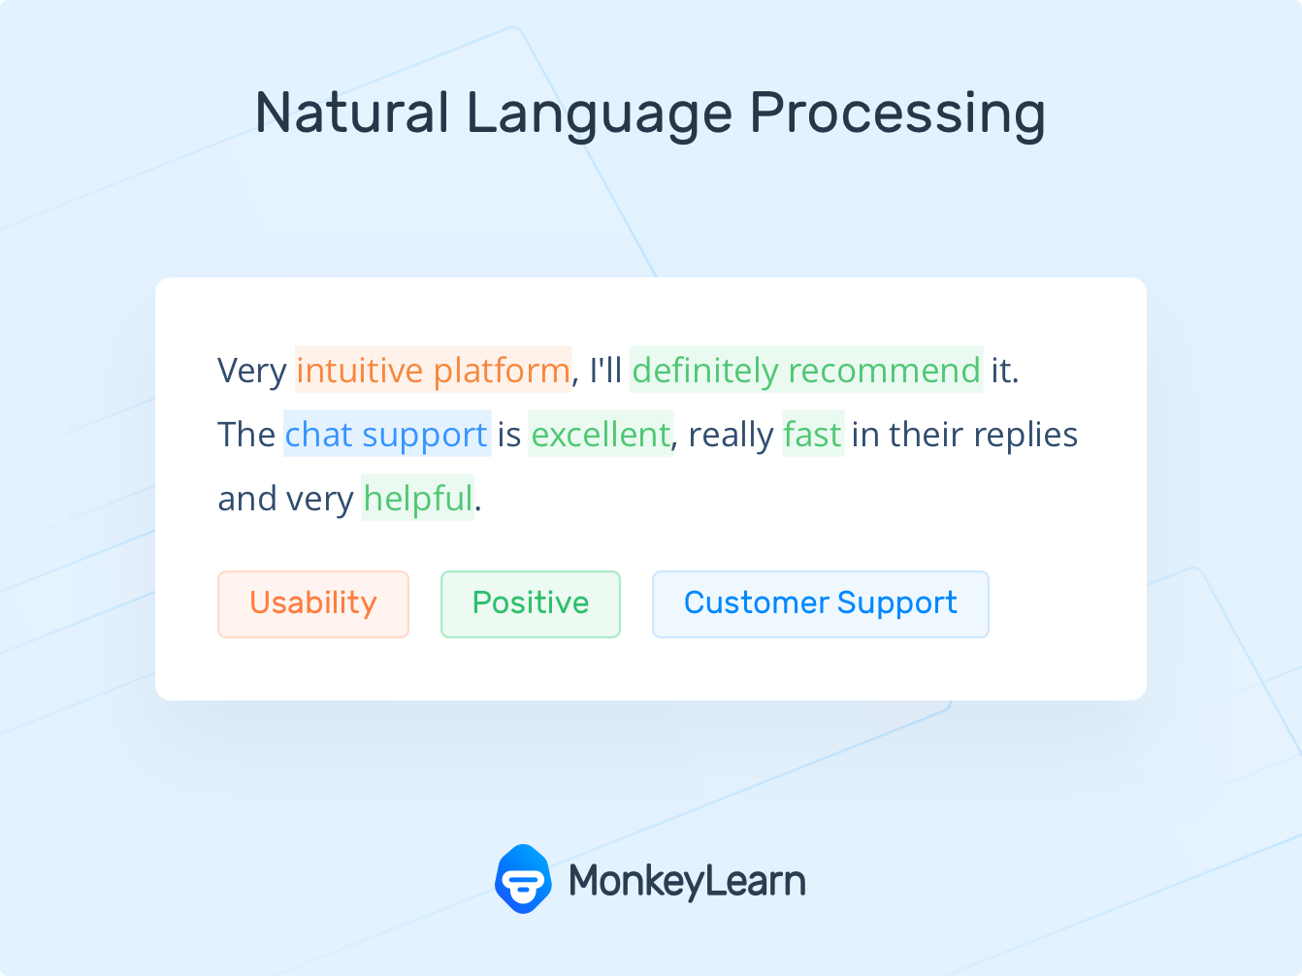
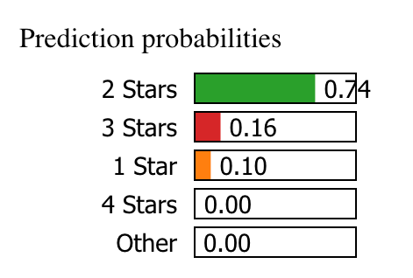
Even More AI
Source
Source

Slide 6
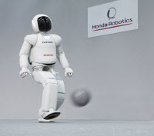
In how many ways can we learn soccer?
Supervised Learning
Unsupervised Learning
Reinforcement Learning
https://asimo.honda.com/gallery.aspx

Slide 7
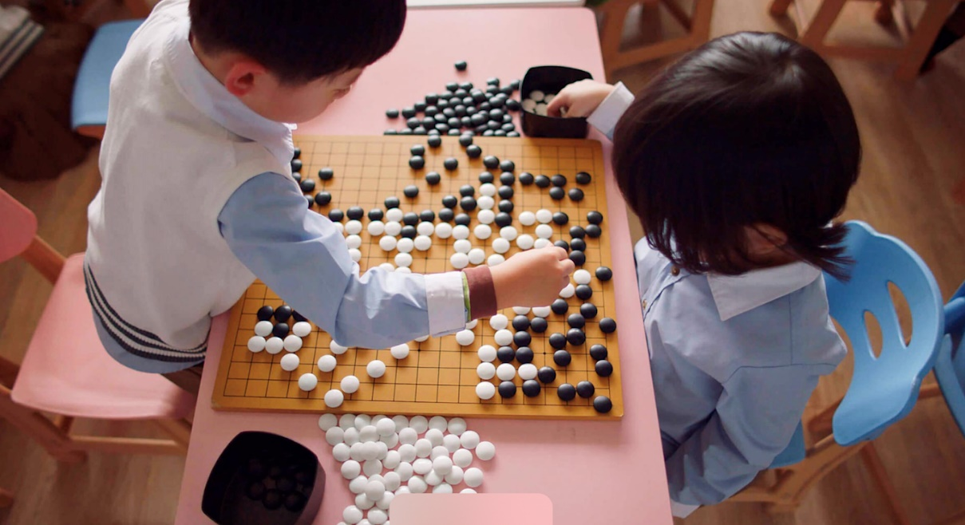
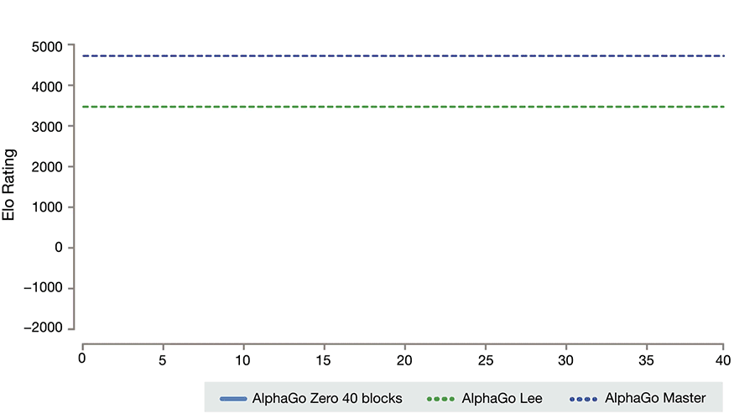
Beating humans?
Source: Deepmind.com

Slide 8
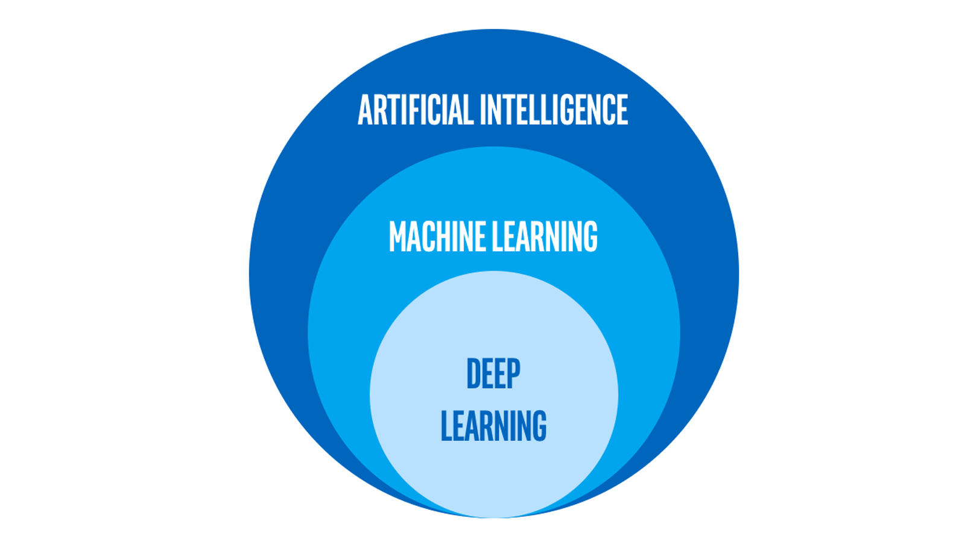
Machine Learning, Deep learning and AI
Intel.com
“Just as electricity transformed almost everything 100 years ago, today I actually have a hard time thinking of an industry that I don’t think AI (Artificial Intelligence) will transform in the next several years.” ~Andrew Ng

Slide 9
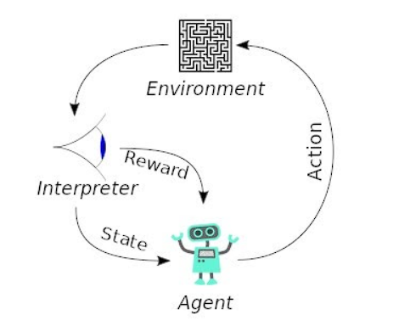
Reinforcement Learning
Check this link
DeepRacer
Source: https://upload.wikimedia.org/wikipedia/commons/1/1b/Reinforcement_learning_diagram.svg

Slide 10
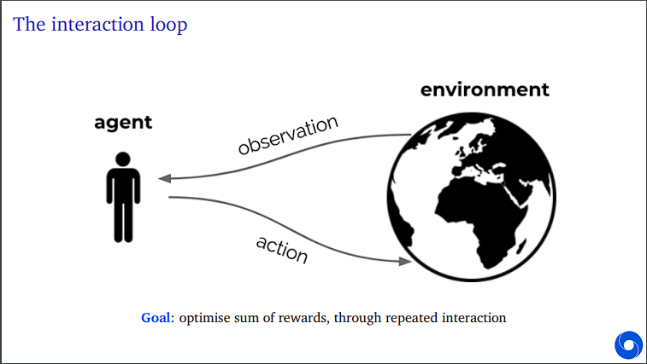
Reinforcement Learning
Source: UC Berkley Lectures

Slide 11
Examples
DeepRacer
Walking Robot
Webots Simulated robot
Turtlesbot!

Slide 12
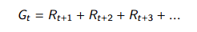
How to formalize a goal???
We describe achieving a goal by maximizing a cumulative reward value
Agent → starts at time t→ makes an action A in some state S → Gets a reward R at t+1 and a new state(obs)→ learns how to maximize this reward over all timesteps

Slide 13
Agent
An agent is the “part” that takes decisions and consists of the following components:
A state → The agent uses to be aware of the world and to take decisions
A policy → Mapping from states to actions
Value Function → How “good” is this state for a given policy
Model → Describes the dynamics of the world

Slide 14
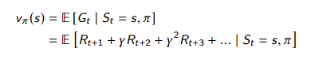

Value function
A value function is defined as the expected value of cumulative reward received from a state given a certain policy
Gamma $γ$ is called a discount factor, used to focus on immediate rewards or later rewards
A policy is the probability of choosing an action A in a state S
A = $π$(S) → $π$= p(A|S)

Slide 15

State Action value function
Q value is the value (expected return(cumulative reward) ) of taking action A in state S
$Q\left(s,a\right)=Ε\left[G_{t} \right|S_{t}=s, A_{t}=a]=Ε\left[R_{t+1}+ γR_{t+2}+γ^{2}R_{t+2} \right|S_{t}=s, A_{t}=a]$
Gamma $γ$ is called a discount factor, used to focus on immediate rewards or later rewards
A policy is the probability of choosing an action A in a state S
A = $π$(S) → $π$= p(A|S)

Slide 16
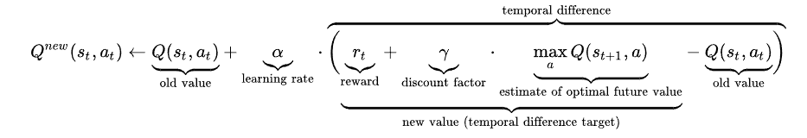
Q learning
Temporal difference method
works by Learning the Q values and choosing actions based on them
Tabular method
Each Q value is learned by the following equation
Source: Wikipedia

Slide 17
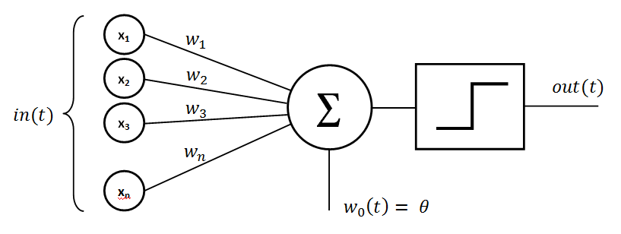
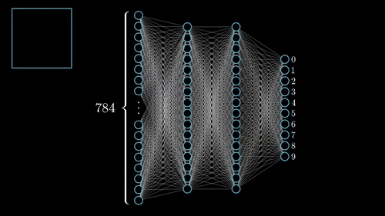
How a neural network looks like ?
By Mayranna - Own work, CC BY-SA 3.0, https://commons.wikimedia.org/w/index.php?curid=30128320
By 3Blue1Brown https://www.3blue1brown.com/

Slide 18


Neural Networks vs…..Actual neurons
From Wikipedia.com
https://www.qwaym.com/our-minds-are-perfectly-intertwined-science-agrees/connected-minds/

Slide 19
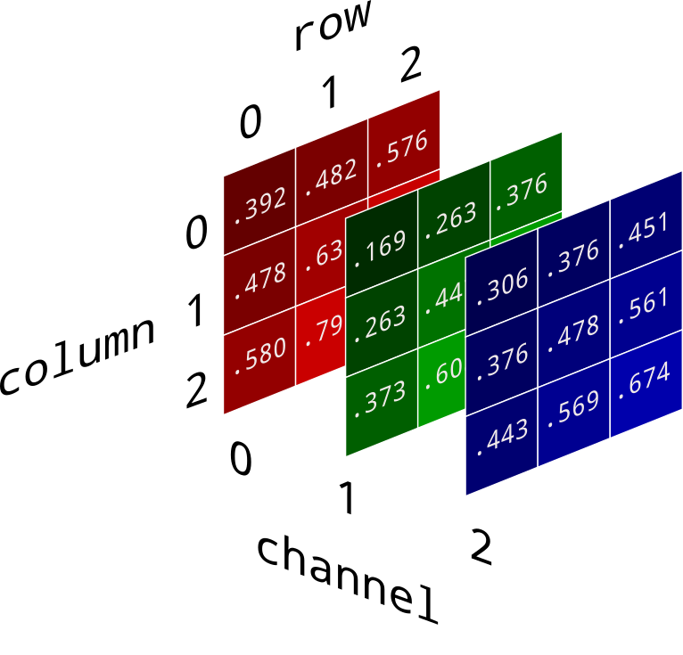

3*3= 9
28*28=784

Slide 20
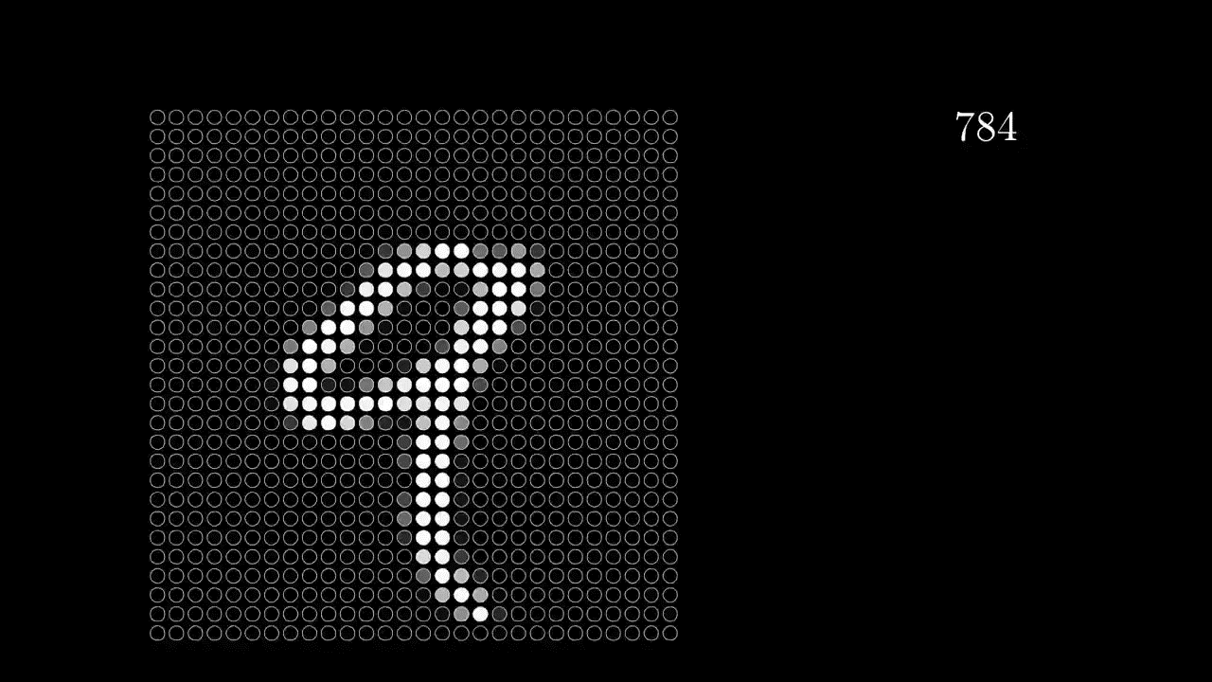
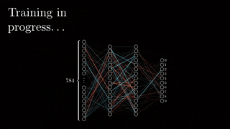
How images are fed into the neural network
By 3Blue1Brown https://www.3blue1brown.com/

Slide 21
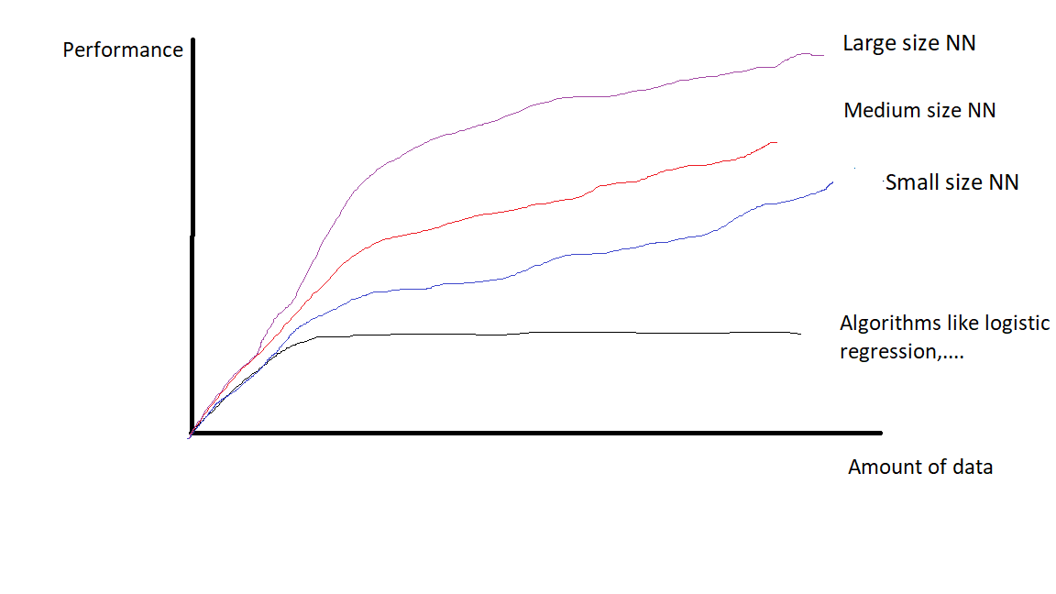
Why deep learning got very famous lately?

Slide 22
Thank you
Abdallah Hesham Mohamed abdallah.hesham@ieee.org

